Slide 1
BIODIVERSISY
IMPORTANCE OF BIODIVERSISY
Biodiversity → variety of species life on the earth.
→ It has four components of biodiversity.
1) Species diversity→ number and abundance of species present
in different ecosystems.
2) Genetic diversity → variety of genetic material within a
species or a population

Slide 2
3) Ecosystem diversity→
earth diversity of biological communities such as
deserts, grasslands, forest and wetlands
4) Functional diversity→
variety of processes such as energy flow and matter
cycling that occur within ecosystems as species interact with
one another in food chains and food webs.

Slide 3
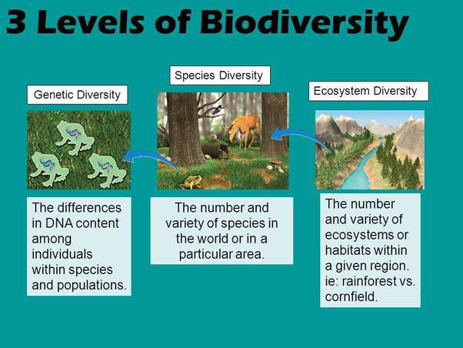
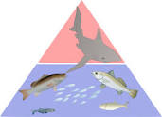

Slide 4
Habitat Destruction and Fragmentation remember HIPPCO
The most important direct causes of species extinction and threats to ecosystem services using HIPPCO :
H : Habitat degradation and extinction
I : Invasive species
P : Population growth and increasing use of resources
P : Pollution
C : Climate change
O : Over exploitation

Slide 5
Extinction → all members of species from the earth. Species can become extinct, when it cannot adapt and successfully reproduce under new environmental condition.
Endangered and threatened species
Endangered species → individual survivors that the species could soon
become extinct.
Threatened species → enough remaining individuals to survive in the
short term, but because of declining numbers, it
is likely to become endangered in the near future.

Slide 6
THREATS TO AQUATIC BIODIVERSITY
Aquatic Biodiversity
Three general patterns related to marine biodiversity :
1) the greatest marine biodiversity occurs around coral reefs in estuaries, and on the deep ocean floor
2) biodiversity is greater near the seaside than in the open sea because of the larger variety of producer and habitats in coastal areas
3) biodiversity is generally greater in the bottom region of the ocean than in the surface region because of larger variety of habitats and food sources on the ocean bottom

Slide 7
How to preserve biodiversity?
1.Save the bees
Bees are important to preserving biodiversity and they are increasingly under attack from mites. you can help save them by planting nectar producing wildflowers in your backyard. And also building bees boxes for local bees to call home.
2. Plant local flowers, fruits and vegetables
Research the flora, fruits and veggies native to your area and plant a variety in your backyard.
3. Respect local habitats
plants growing in the parks and nature preserves near you often play an important role in preserving the local ecosystem.

